Slide 1

UM-1: AMAZON SALES DATA ANALYSIS

Slide 2
INTRODUCTION
The Amazon Sales Data project focuses on analyzing sales trends, customer preferences, and product performance across various categories. Using a dataset spanning [insert time period], the project aims to uncover patterns in revenue generation, seasonal sales trends, and customer ratings. Insights derived from this analysis can help optimize product strategies and improve customer satisfaction. This project highlights the power of data-driven decision-making for e-commerce success.

Slide 3
OBJECTIVE
To Develop a Report by Extracting-Transforming-Loading of data which contains Sales trend with respect to Yearl-wise, Month-wise, Yearly_month-wise and find insightful relationships between attributes through data to understand and analyze the Facts.

Slide 4
BENEFITS
Help out to make better business decisions.
Help analyze customer trends and satisfaction, which can lead to new and better products and services.
Gives better insight of customers base.
Helps in easy flow for managing resources.

Slide 5
PROBLEM STATEMENT
E-commerce platforms like Amazon face challenges in understanding sales trends, customer preferences, and product performance across diverse categories. Identifying patterns in revenue, seasonal variations, and customer behavior is crucial for optimizing inventory and marketing strategies. This project aims to address these gaps through data analysis, providing actionable insights to enhance decision-making.

Slide 6
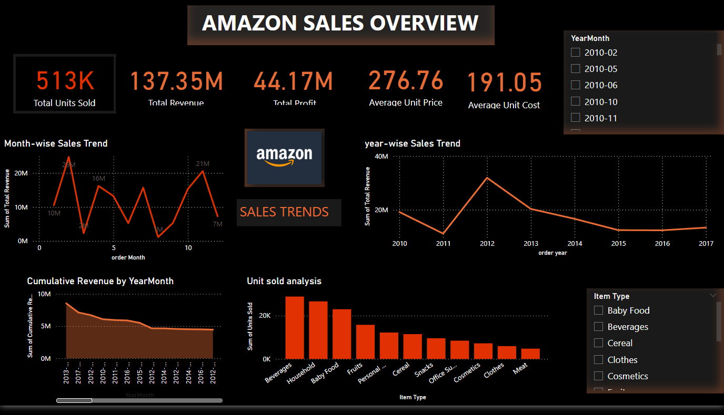
MY DESIGN

Slide 7
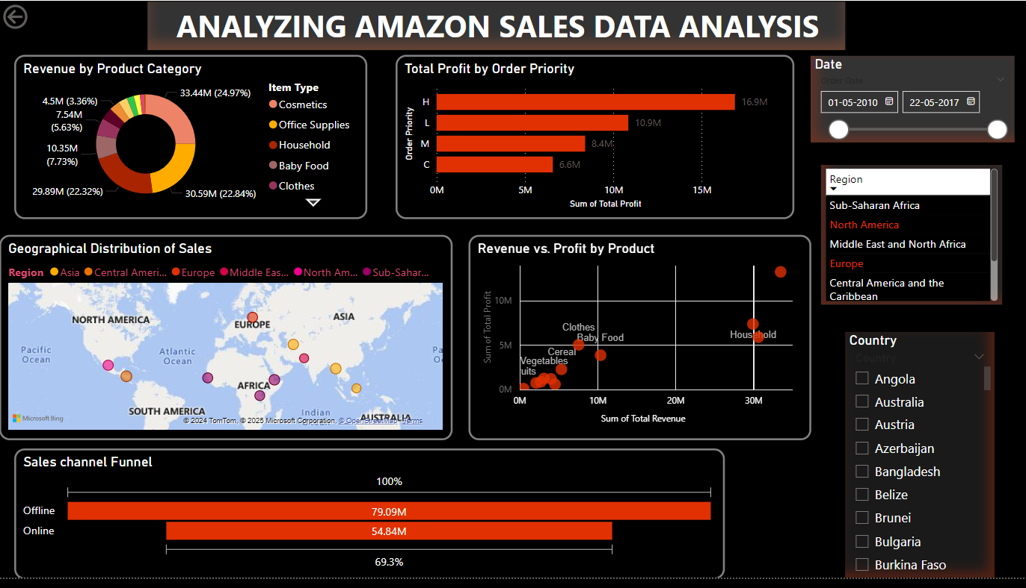

Slide 8
THANKYOU!!

